Slide 1





FINMARK CORPORATION
TERMINAL ASSESSMENT: ML SOLUTION PRESENTATION
Presented By: Group 2 Ana Marie Morcilla / Busadre Jose Jr Math for Machine Learning: Linear Algebra H3101
Notes:
Good day everyone. This presentation covers our machine learning solution project for FinMark Corporation.
We explored three datasets covering customer demographics, transactions, and social media interactions. I will follow the same four major sections in our assessment template: the problem statement, project overview and process, EDA results and findings, and our recommended machine learning solution.

Slide 2

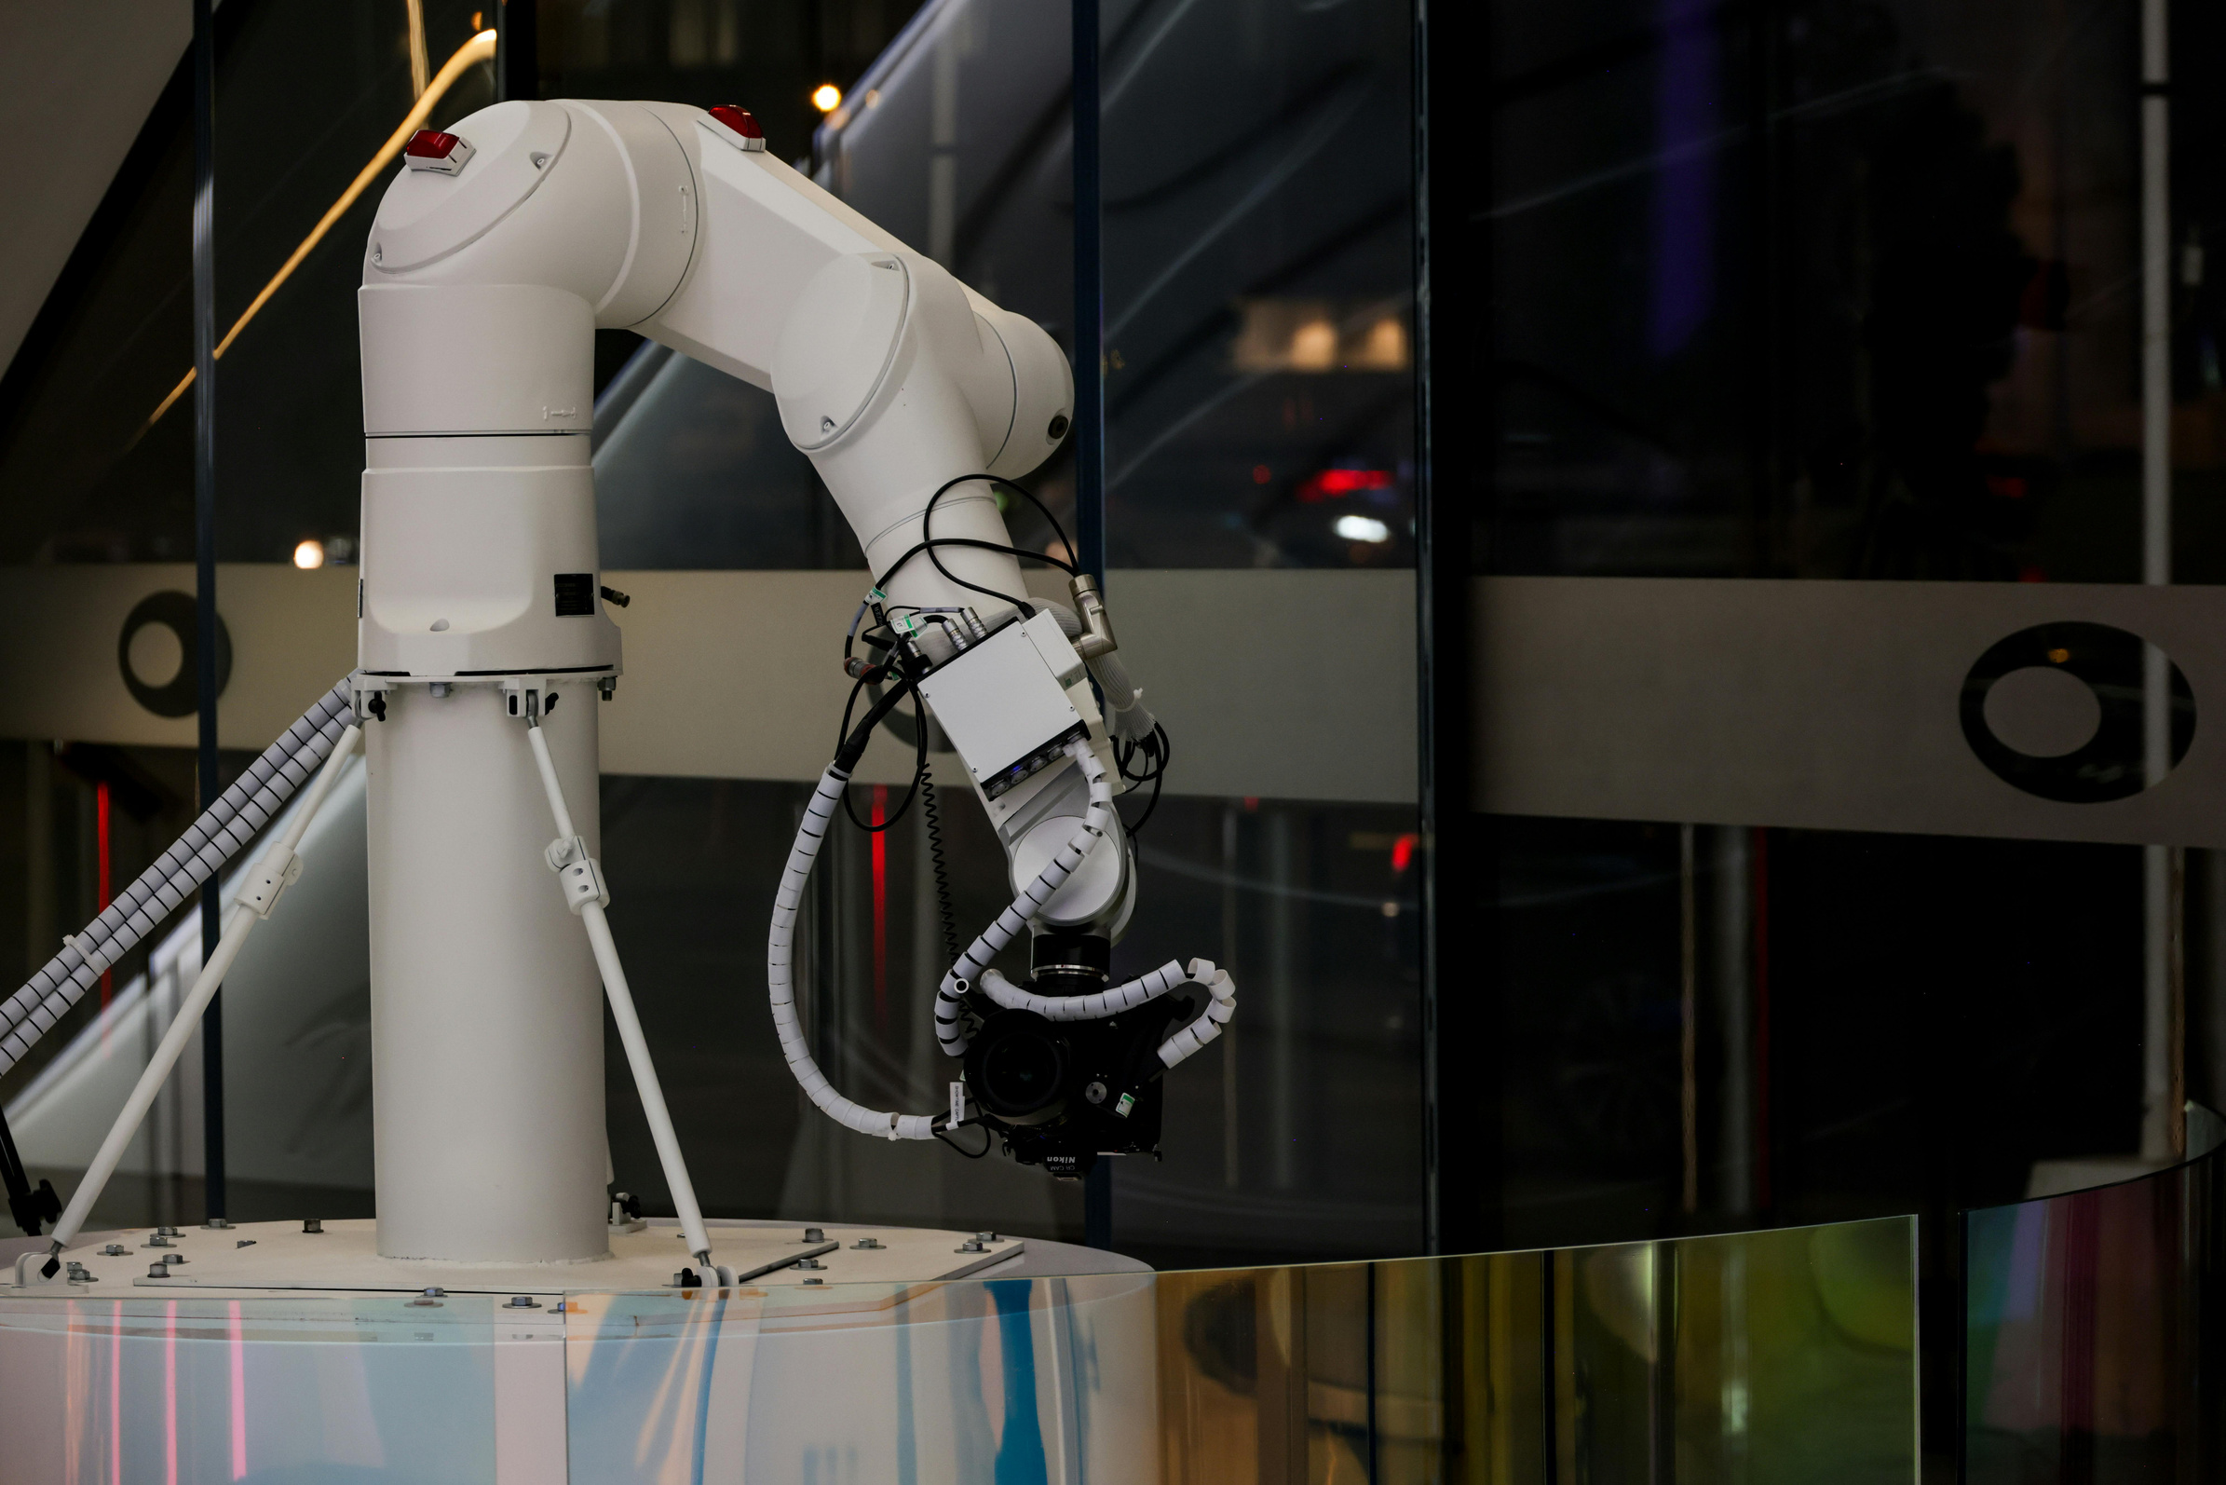
PROBLEM STATEMENT
FinMark's customer information is stored in separate datasets.
·Data quality concerns in the raw datasets included missing and inconsistent values, duplicate rows, and unusual transaction amounts.
These issues make it difficult to understand customer behavior and identify market patterns.
Datasets: demographics (3,000 records), transactions (3,015), and social media (3,020).
Total: 9,035 records across the three datasets—not 9,035 unique customers.
Notes:
FinMark collects information from different business activities. The demographic dataset describes customer profiles, the transaction dataset records purchasing activity, and the social media dataset captures online interactions.
However, these datasets are stored separately and contain data quality concerns, including missing values, inconsistent entries, duplicate rows, and unusual values. These issues make it harder to examine customer behavior as one connected picture and identify useful market patterns.
Our project addresses this by exploring and preparing the three datasets, examining their characteristics through statistics and visualizations, and identifying a suitable machine learning approach. The cleaned demographics dataset contains 3,000 records, transactions contains 3,015, and social media contains 3,020, for a total of 9,035 records. This total should not be interpreted as 9,035 unique customers because transaction and social media datasets can contain multiple records for the same customer.

Slide 3




Workflow: Load → Inspect → Clean → Analyze → Visualize.
Reviewed dataset structure, data types, missing values, exact duplicates, and unusual entries
Removed exact duplicate rows; repeated CustomerID values in transaction/social datasets may represent valid multiple activities
PROJECT OVERVIEW, DEVELOPMENTAL STEPS, AND PROCESS
Converted date fields; missing social Platform and Sentiment values were represented as Unknown.
WORKFLOW AND PREPARATION
Tools: Pandas, NumPy, Matplotlib, and Seaborn.
Notes:
Our project followed an exploratory data analysis workflow. We loaded the three datasets into Python and inspected their structure, row and column counts, data types, missing values, duplicate records, and unusual entries. We then cleaned each dataset separately.
Exact duplicate rows were removed. In the demographics dataset, customer-level records were reviewed so the cleaned file retained 3,000 unique CustomerID records. In the transaction and social media datasets, repeated CustomerID values were not automatically considered duplicates because one customer can make multiple purchases or interactions. We converted date fields to support time-based analysis. In the social media preprocessing, missing
Platform and Sentiment values, including the text value None for Sentiment, were represented as Unknown. The initial inspection also identified missing and invalid demographic values, non-numeric transaction amounts such as Free, and zero or negative transaction amounts. During transaction preprocessing, invalid or unavailable Amount values, including non-numeric, zero, and negative values, were handled through the cleaning process and median imputation.
The updated cleaned datasets contain no remaining null values or exact duplicate rows. However, Unknown categories and the effect of median imputation on the transaction amount distribution still need to be considered. We used Pandas, NumPy, Matplotlib, and Seaborn for data preparation, numerical analysis, and visualization.

Slide 4
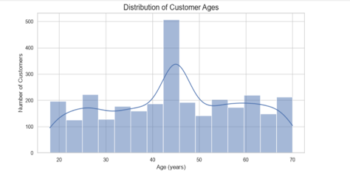
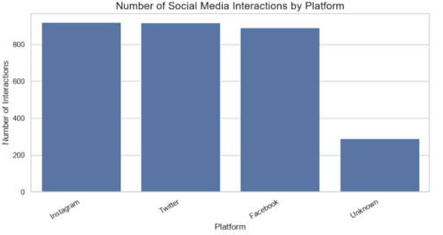
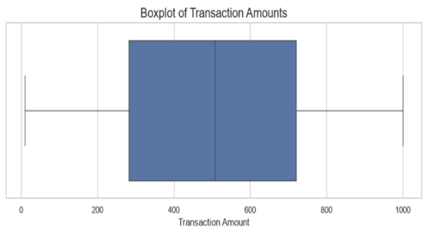
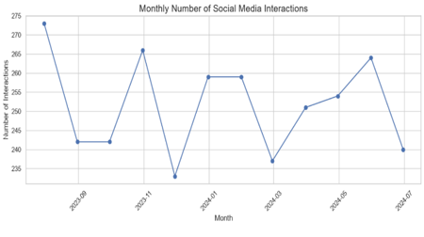
PROJECT OVERVIEW, DEVELOPMENTAL STEPS, AND PROCESS
ANALYSIS AND VISUALIZATION
Visualization 1: Customer Age Distribution
Visualization 2: Social Media Interactions by Platformion
Visualization 3: Transaction Amount Outliers
Visualization 4: Monthly Interaction Trends
01
02
03
04
05
Descriptive statistics were used for numerical fields.
Frequency counts were used to examine categorical fields.
Histograms and boxplots examined numerical distributions.
Bar charts compared categories; monthly charts showed activity over time.
CustomerID can connect datasets, but raw one-to-many records should be summarized before joining.
Notes:
After preprocessing, we used descriptive statistics to summarize numerical variables and frequency counts to examine categorical variables. Histograms and boxplots helped us understand numerical distributions and identify unusual values.
Bar charts were used to compare categories, while monthly charts helped us observe changes in transaction and social media activity over time. The project used these visualizations to support and communicate the EDA findings.
The datasets can be related through CustomerID, but they should not be joined as raw tables without considering their different levels of detail. One customer may have many transactions and many social media interactions.
A direct join could multiply records and distort totals. For a customer-level machine learning dataset, transaction and social media information should first be summarized for each customer and then combined with demographic information.

Slide 5
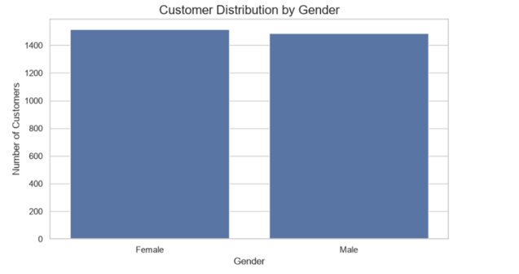
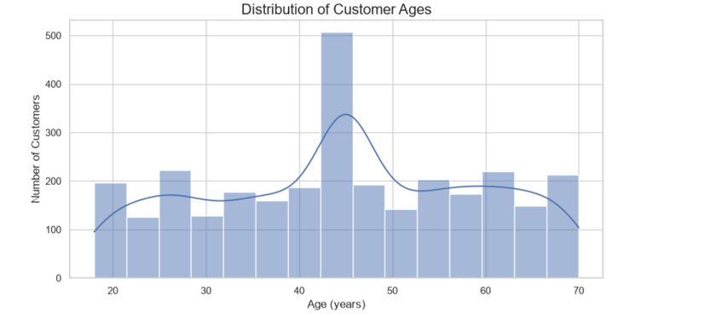
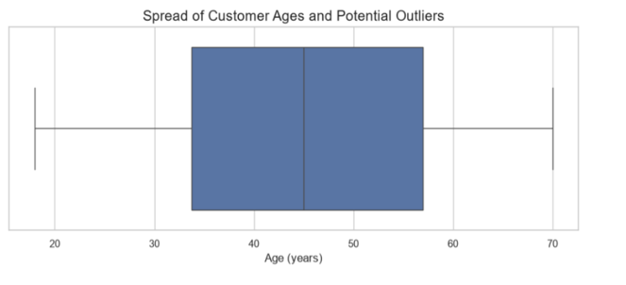
EXPLORATORY DATA ANALYSIS RESULTS AND FINDINGS
Visualization 2: Customer Gender Distribution
DEMOGRAPHICS AND TRANSACTIONS
Customer Demographics – 3 charts
Visualization 1: Customer Age Distribution
Visualization 3: Customer Age Spread and Potential Outliers
Demographics: Age 18–70; mean 44.66; median 45; standard deviation 14.45.
Gender: 1,515 female (50.5%) and 1,485 male (49.5%).
Most frequent reported categories: Clothing (571) and Debit Card (767).
Transactions: mean Amount 490.50; median 496.62; SD 283.28; range -100 to 999.86.
The concentration near the median may partly reflect median imputation during preprocessing.
Largest age concentration: around the mid-40s.
Notes:
For customer demographics, ages range from 18 to 70 years. The mean age is approximately 44.66, the median is 45, and the standard deviation is about 14.45. The histogram shows the largest concentration around the mid-40s.
The gender distribution is almost balanced, with 1,515 female customers, or 50.5 percent, and 1,485 male customers, or 49.5 percent. For transactions, the average Amount is approximately 504.81 and the median is about 508.07. The standard deviation is approximately 270.29, and the cleaned values range from 10.03 to 999.86.
The middle 50 percent of transaction amounts fall between approximately 282.02 and 720.39. Clothing is the most frequent product category in the reported counts, with 571 records, while Debit Card is the most frequent payment method, with 767 records. The transaction histogram shows a noticeable concentration near the median.
This may partly reflect the median imputation performed during preprocessing, so we should not automatically interpret the peak as a natural customer spending preference. The cleaned dataset contains no remaining negative or zero transaction amounts.

Slide 6
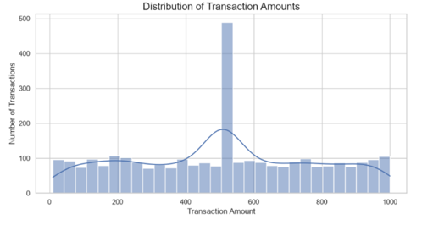
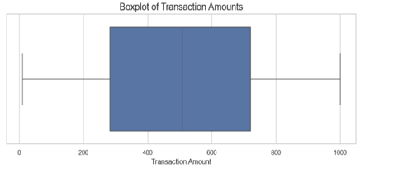
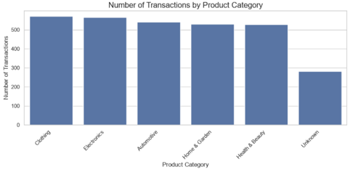
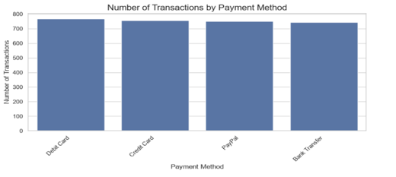
EXPLORATORY DATA ANALYSIS RESULTS AND FINDINGS
DEMOGRAPHICS AND TRANSACTIONS
Customer Transactions – 4 charts
4. Transaction Amount Distribution – histogram
5. Transaction Amount Outliers – boxplot
6. Transactions by Product Category – bar chart
7. Transactions by Payment Method – bar chart
Notes:
For customer demographics, ages range from 18 to 70 years. The mean age is approximately 44.66, the median is 45, and the standard deviation is about 14.45. The histogram shows the largest concentration around the mid-40s.
The gender distribution is almost balanced, with 1,515 female customers, or 50.5 percent, and 1,485 male customers, or 49.5 percent. For transactions, the average Amount is approximately 504.81 and the median is about 508.07. The standard deviation is approximately 270.29, and the cleaned values range from 10.03 to 999.86.
The middle 50 percent of transaction amounts fall between approximately 282.02 and 720.39. Clothing is the most frequent product category in the reported counts, with 571 records, while Debit Card is the most frequent payment method, with 767 records. The transaction histogram shows a noticeable concentration near the median.
This may partly reflect the median imputation performed during preprocessing, so we should not automatically interpret the peak as a natural customer spending preference. The cleaned dataset contains no remaining negative or zero transaction amounts.

Slide 7
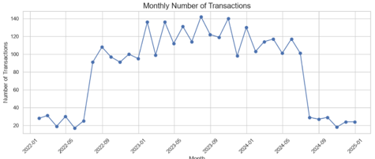
EXPLORATORY DATA ANALYSIS RESULTS AND FINDINGS
TRENDS AND SOCIAL MEDIA
Transaction Trend – 1 chart
1. Monthly Number of Transactions – line chart
Monthly transactions rose around mid-2022 and remained higher through 2023 and the first half of 2024; a sharp decline appears in the second half of 2024.
Check date coverage and dataset completeness before interpreting the decline.
Notes:
The monthly transaction chart shows activity increasing around the middle of 2022 and remaining higher through 2023 and the first half of 2024. A sharp decline appears in the second half of 2024. This should be checked against the dataset's date coverage and completeness before concluding that actual customer activity declined.

Slide 8
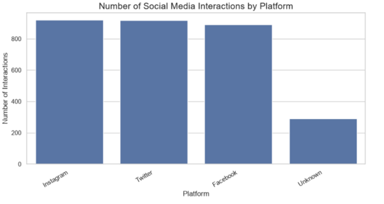
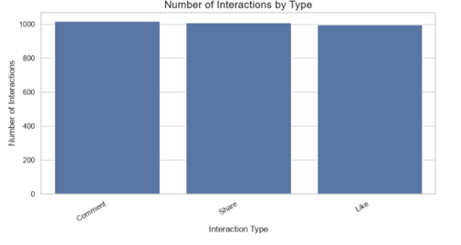
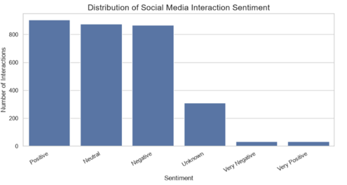

EXPLORATORY DATA ANALYSIS RESULTS AND FINDINGS
TRENDS AND SOCIAL MEDIA
Interactions by Platform
Social Media – 4 charts
Interactions by Platform
Sentiment Distribution
Monthly Social Media Interactions
Platforms: Instagram 921 (30.50%); Twitter 917 (30.36%); Facebook 891 (29.50%); Unknown 291 (9.64%).
Interaction types: Comments 1,018; Shares 1,007; Likes 995.
Sentiment: Positive 905; Neutral 874; Negative 866; Unknown 309.
Monthly social media interactions fluctuate around 233–273.
Notes:
For social media, Instagram has 921 records, Twitter has 917, and Facebook has 891, while 291 records are categorized as Unknown for Platform. Comments are the most frequent interaction type, with 1,018 records, followed by Shares with 1,007 and Likes with 995. Positive sentiment is the largest category at 905 records, followed by Neutral at 874 and Negative at 866.
There are also 309 Unknown sentiment records. Monthly social media interactions fluctuate from approximately 233 to 273, with no consistent upward or downward trend across the period shown. Overall, the datasets provide three useful views of customers: profiles, purchasing activity, and online engagement.
However, the current visualizations mainly describe individual variables. They do not yet establish relationships or correlations between customer characteristics, purchasing behavior, and social media engagement. Further grouped comparisons, cross-tabulations, and statistical tests would be needed.

Slide 9

02
03
Suitable for mixed numerical and categorical customer features; unsupervised learning does not require a predefined customer-group label.
Potential use: explore groups with similar profiles, purchasing patterns, and social media engagement.
RECOMMEND SPECIFIC MACHINE LEARNING SOLUTIONS, ALGORITHMS, OR TECHNIQUES
04
05
K-Means is an alternative after encoding categorical variables and scaling numerical features.
Linear Regression and Classification require a defined numerical or categorical target.
06
01
No clustering model has been trained or evaluated in this project.
Primary recommendation: K-Prototypes Clustering.
Notes:
Based on the available datasets and EDA findings, we recommend K-Prototypes Clustering as the primary machine learning approach for further exploration.
FinMark's data contains numerical features, such as Age and summarized transaction measures, as well as categorical features, such as Gender, IncomeLevel, ProductCategory, PaymentMethod, Platform, InteractionType, and Sentiment.
K-Prototypes is designed to work with a combination of numerical and categorical features. Clustering is an unsupervised learning approach, so it does not require an existing target label that identifies each customer's group.
This is suitable for the current project because the EDA and DataViz work describe customer characteristics and behavior, but do not define a specific outcome to predict. A future clustering analysis could investigate whether customers with similar demographic profiles, purchasing patterns, and social media engagement can be grouped together. Before applying it, transaction and social media records should be summarized at customer level and combined with demographic information. CustomerID, TransactionID, and InteractionID should not be used as model features because they identify records rather than describe customer behavior.
K-Means is another possible method, but categorical variables would need to be encoded and numerical features scaled. Linear Regression and Classification may be useful later if FinMark defines a clear numerical or categorical target. The proposed clustering approach still requires data validation, feature preparation, selection of the number of clusters, and evaluation.
No clustering model has been trained or evaluated in the submitted work, so no actual cluster assignments or performance scores are being reported. In conclusion, K-Prototypes is our recommended next step because it can accommodate mixed customer data and support exploratory customer segmentation, subject to careful preparation and evaluation. Thank you.

Slide 10
THANK YOU
FOR YOUR ATTENTION
Notes:
It's time to wrap up our presentation, so I want to sincerely thank you all for your time and attention today.
We've covered a lot of ground, from analyzing social media trends to exploring potential machine learning solutions. Your engagement and insights have been invaluable.
As we conclude, I encourage you to think about how these findings and recommendations can be applied to your own projects and strategies.
[Pause for a moment to allow the audience to reflect.]
Remember, the key takeaway is the potential of clustering techniques like K-Prototypes to unlock new insights into customer behavior and engagement.
We look forward to any questions you might have or further discussions on this topic.
[Pause to invite questions or comments from the audience.]
Thank you once again, and let's continue to explore these exciting possibilities together.
[Smile and make eye contact with the audience.]

